Slide 1
Capstone 1 Part 2

Slide 2
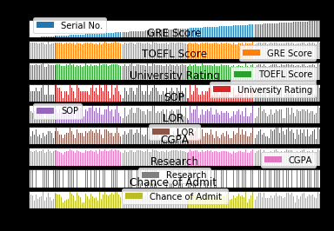

Slide 3
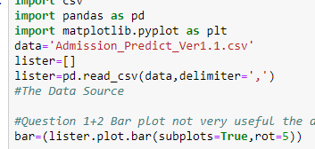
Bar Char
Bar plot not very useful the data is too large to really be able to understand any of the variables from this bar chart
*

Slide 4
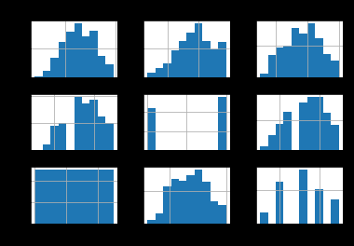
Histogram
Its interesting the number of university rating > 3 is over 150 as the expected value is 100. 4 is right at that level and 2 is slight above ~120. 1 is the lest with less than 30 and 5 is around 60. The LOR has a gap on its histogram with hinders any form of distribution from being inferred from it. Chance of admit is skewed to the right which means that the chance of getting in is higher than 50% which is extremely important for the concept of the problem. I can weave this in story telling by manipulating the problem to address more of an increasing percentage versus current percentage rather than raw chance. I am curious how this breaks down at a university rating.
*

Slide 5
Histogram Part 2
A raw chance to admit has a very different story than most undergraduates perhaps I will have to focus this study on schools within a student's range rather than creating a model for all schools. GRE tends to be fairly normal along with SOP and TOEFL but with a high level base it may be interesting how i chose to transform these variables to develop a more of numerical model that would be continuous. Perhaps I break it down into percentage possible, or percentile or simply subtracting a number to normalize the results. the CGPA seem to be a relatively normal distribution # Chance The university rating break down is very interesting majority are 3. Far more 2's there are 4.
*

Slide 6
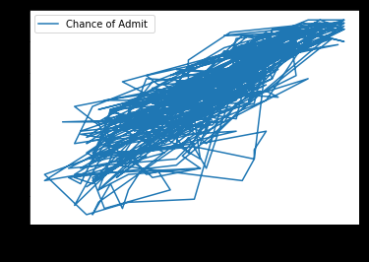
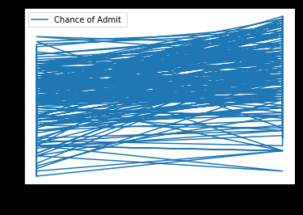
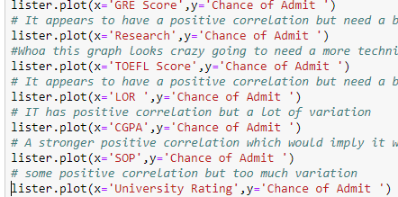
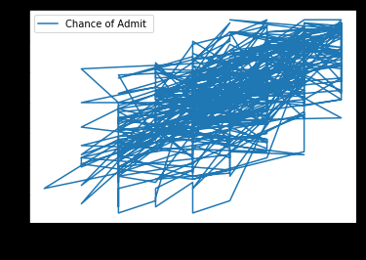
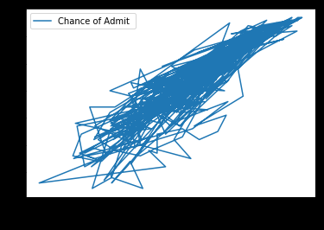
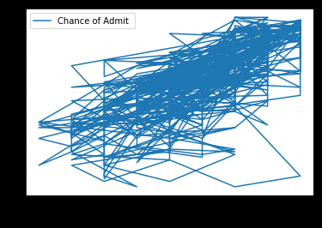
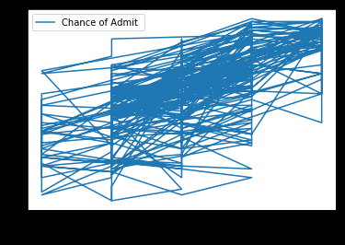
Two Related Quantities
It appears to have a positive correlation but need a better graphing tool
Whoa this graph looks crazy going to need a more technical method to address this.
It appears to have a positive correlation but need a better graphing tool like GRE. Maybe slightly more variation
IT has positive correlation but a lot of variation A stronger positive correlation which would imply it would have the biggest impact in an increase.
Some positive correlation but too much variation
6. There is some positive correlation but it appears to focus more on chance of admits floor rather than university rating.
This is confounding most likely because students that are underqualified don't apply to good universities.
*

Slide 7
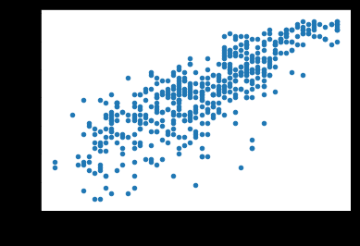
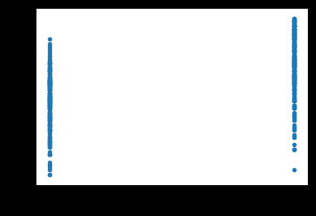
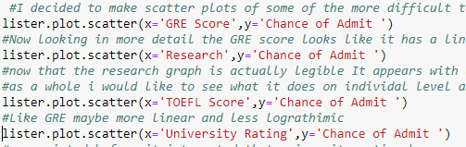
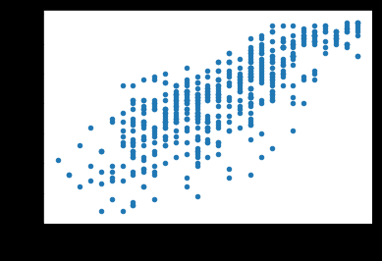
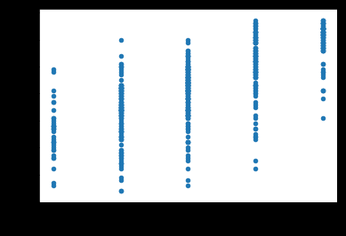
Scatterplot
Decided to make scatter plots of some of the more difficult to under stand plots to see if scatter would give me some more insight.
Now looking in more detail the GRE score looks like it has a linear relationship but perhaps even more of a logarithmic scale would work better.
now that the research graph is actually legible It appears with exception of one outlier that research makes a small impact on chance of admit as a whole I would like to see what it does on individual level and when it is controlled.
Like GRE maybe more linear and less logarithmic
As pointed before it interested that university rating has a correlation with chance of admit but I believe this to be a confound variable
.
*

